Slide 1


Product Lifecycle Information
&
Roadmaps
Slide Deck
Data Validated
as of
January 13, 2022

Slide 2
Slide List
Teradata Database Roadmap
Teradata Database Release Information
TTU Release Information
Teradata Platform Roadmap
Teradata BAR
Viewpoint, Ecosys Mgr, Data Mover, Unity, DSA
Hadoop Roadmap
Hadoop Release Information
Hadoop Platform Compatibility
TD Hadoop to Hortonworks Hadoop Comparison
Aster Database Roadmap
Aster Database Release Information
Aster Analytics
Aster Platform Roadmap

Slide 3
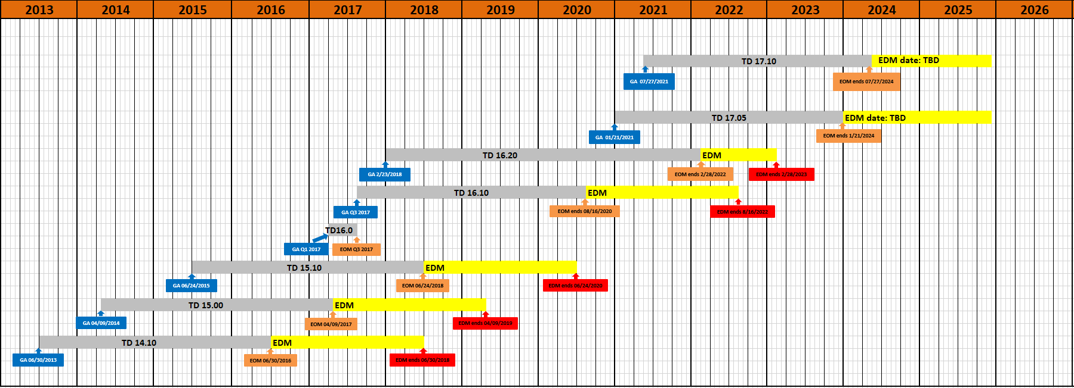
Teradata Database Roadmap

Slide 4
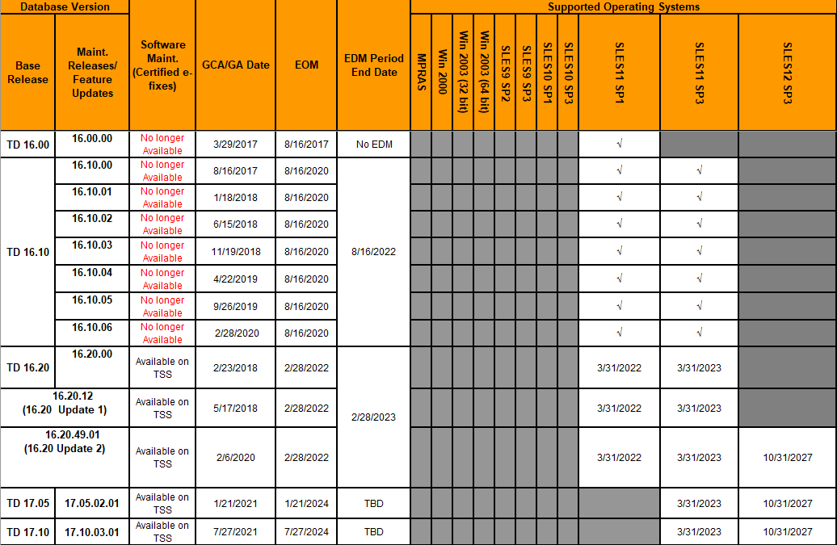
Teradata Database Release Information

Slide 5
TTU Release Information
Teradata Tools & Utilities (TTU) Maintenance Release Roadmap
This document is published by Teradata Customer Service on behalf of Teradata Product Management
Dates and policies listed here are the best information available at the date of publication
Current Teradata Tools & Utilities (TTU) Software Support Table and Timeline:
Teradata Database Software Versions Current and Future
 | TTU Version | GCA | Released / Future [1] | EOM | EOM Note
 | 14.10 | Mar-13 | Released | 30-Jun-16 | Align w/TD14.10 EOM
 | 15.00 | Apr-14 | Released | 9-Apr-17 | Align w/TD15.00 EOM
 | 15.10 | 15-Apr-15 | Released | 24-Jun-18 | Align w/TD15.10 EOM
 | 16.00 | 29-Mar-17 | Released | 16-Aug-17 | Align w/TD16.00 EOM
 | 16.10 | 16-Aug-17 | Released | 16-Aug-20 | Align w/TD16.10 EOM
 | 16.20 | 23-Feb-18 | Released | 28-Feb-22 | Align w/TD16.20 EOM*
 | 17.00 | 22-Jun-20 | Released | 21-Jan-24 | Align w/TD17.05 EOM*
 | 17.10 | 22-Jun-21 | Released | 27-Jul-24 | Align w/TD17.10 EOM*
Important Notes: | *Arc 16.20 EOM is Feb 28, 2021 [1] Dates marked "Future" or "(P)" are planning dates only. Teradata reserves the right to change these dates at its discretion, although every effort will be made to maintain the date(s)
TTU Database Support
H TTU Version Below Supports Database VersF | TD 6.2 | TD 12.0 | TD 13.0 | TD 13.10 | TD 14.00 | TD 14.10 | TD 15.00 | TD 15.10 | TD 16.10 | TD 16.20 | TD 17.00/17.05 | TD 17.10
TTU 14.10 (2 Forward, Current + 4 Back) |  | ü | ü | ü | ü | ü | ü | ü
TTU 15.00 (2 Forward, Current + 4 Back) |  |  | ü | ü | ü | ü | ü | ü | ü
TTU 15.10 (2 Forward, Current + 4 Back) |  |  |  | ü | ü | ü | ü | ü | ü | ü
TTU 16.10 (2 Forward, Current + 4 Back) |  |  |  |  | ü | ü | ü | ü | ü | ü | ü
TTU 16.20 (2 Forward, Current + 4 Back) |  |  |  |  |  | ü | ü | ü | ü | ü | ü | ü
TTU 17.00 (2 Forward, Current + 3 Back) |  |  |  |  |  |  |  | ü | ü | ü | ü | ü
TTU 17.10 (2 Forward, Current + 3 Back) |  |  |  |  |  |  |  |  | ü | ü | ü | ü

Slide 6
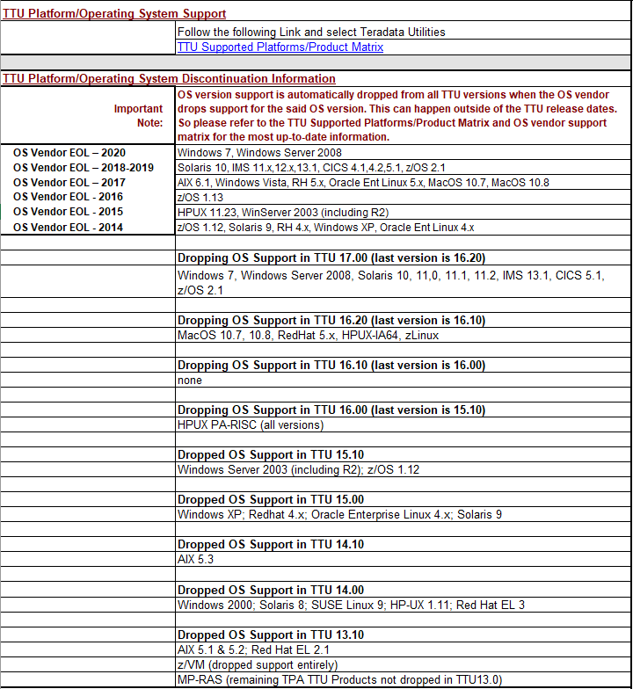
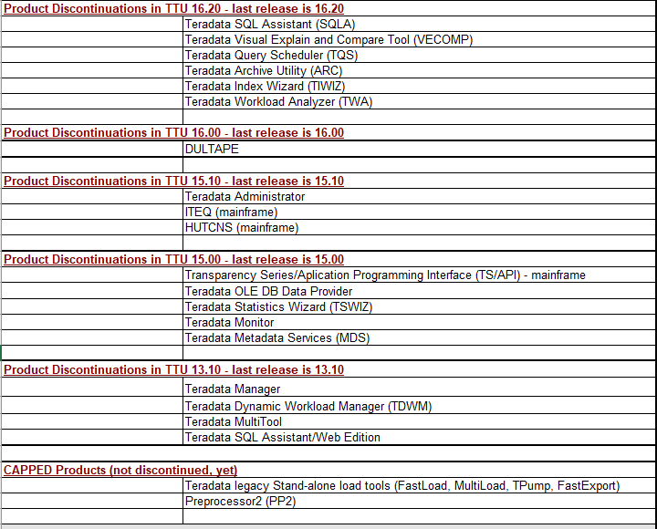
TTU Release Information

Slide 7
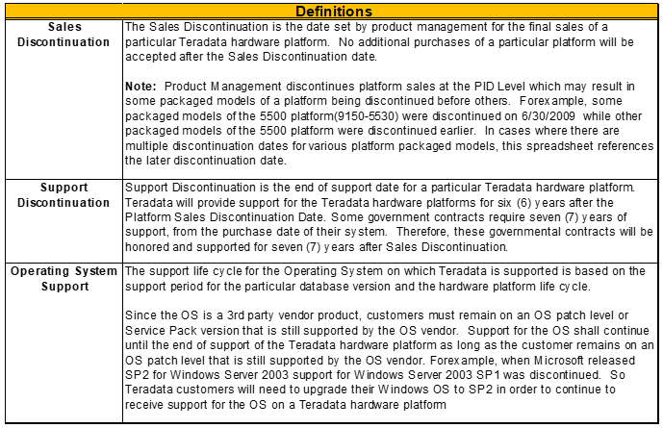
Teradata Platform Roadmap
Hardware Platform |  |  | Sales Discontinuation | Support Discontinuation
Category | Class | Model
MPP | 9165 | 6650 | 5/30/2013 | 5/30/2019
 | 9165 | 6680 | 12/5/2012 | 12/5/2018
 | 9174 | 6690 | 5/30/2013 | 5/30/2019
 | 9175 | 6700C | 9/11/2015 | 9/11/2021
 | 9175 | 6700H | 11/14/2014 | 11/14/2020
 | 9219 | 6750H | 11/9/2015 | 11/9/2021
 | 9219 | 6750X | 11/9/2015 | 11/9/2021
 | 9221 | 6800H 6800C | 3/30/2018 | 3/30/2024
 | 9185 | IntelliFlex 1.0 IntelliFlex 1.1 | 3/30/2018 | 3/30/2024
 | 9185 | InteliFlex 2.0 | 3/30/2018 | 3/30/2024
 | 9185 | IntelliFlex 2.1 | 6/30/2021 | 6/30/2027
 | 9185 | InteliFlex 2.1.1 IntelliFlex 2.5 | Current Product | Current Product
Appliance | 9163 | 1650 | 7/2/2013 | 7/2/2019
 | 9177 | 1700 | 11/9/2015 | 11/9/2021
 | 9193 | 1800 | 3/30/2018 | 3/30/2024
 | 1611 | SAS720 | 12/31/2015 | 12/31/2021
 | 9157 | 2580 | 1/31/2011 | 1/31/2017
 | 9163 | 2650 | 12/1/2012 | 12/1/2018
 | 9164 | 2690 | 1/3/2014 | 1/3/2020
 | 9170 | 2700 | 8/1/2014 | 8/1/2020
 | 9218 | 2750 | 4/6/2015 | 4/6/2021
 | 9192 | 2800 | 7/31/2017 | 7/31/2023
 | 9193 | 2850 | 3/30/2018 | 3/30/2024
 | 9162 | 4600 | 12/5/2012 | 12/5/2018
 | 9194 | IntelliBase 1.0 | 10/31/2018 | 10/31/2024
 | 9194 | IntelliBase 2.0 | (Discontinuation - subject to inventory depletion) 12/31/2019 | 12/31/2025
SMP | 9163 | 560P | 4/30/2013 | 4/30/2019
 | 9175 | 670C | 9/30/2015 | 9/30/2021
 | 9191 | 680 SMP | 6/30/2017 | 6/30/2023
TMS | 9175 | 670H | 10/16/2015 | 10/16/2021
 | 9212 | R710 | 1/3/2014 | 1/3/2020
 | 9212 | R720 | 3/29/2016 | 3/29/2022
 | 9214 | R720 | 3/29/2016 | 3/29/2022
 | 9221 | R720 | 3/29/2016 | 3/29/2022
 | 9219 | R720 | 3/29/2016 | 3/29/2022
 | 9190 | R720 | 3/29/2016 | 3/29/2022
 | 9218 | R720 | 3/29/2016 | 3/29/2022
 | 9216 | R720 | 3/29/2016 | 3/29/2022
 | 9177 | R720 | 3/29/2016 | 3/29/2022
 | 9228 | R730 | 8/15/2018 | 8/15/2024
 | 9229 | R740 | Current Product | Current Product
 | BAR TMS' | R730 | 10/31/2018 | 10/31/2024
Disk Array |  | PowerConnect 6248 | 9/30/2015 | 9/30/2021
 |  | 6844 | 5/30/2013 | 5/30/2019
 |  | 6854 | 1/3/2014 | 1/3/2020
BAR Storage | DD890 |  | 3/31/2014 | 3/31/2019
 | DD4200 |  | 7/28/2017 | 7/28/2022
 | DD7200 |  | 7/28/2017 | 7/28/2022
 | DD6800 |  | 8/28/2020 | 8/15/2025
 | DD9300 |  | 8/28/2020 | 8/15/2025
 | i80 | with HP Drives | 12/31/2016 | 12/31/2021
 | i500 | with IBM Drives | 12/31/2018 | 12/31/2023
Aster | 9230 | Aster Appliance 2 | 8/12/2014 | 8/12/2020
 | 9231 | Aster Appliance 3 | 12/23/2014 | 12/23/2020
 | 9231 | Aster Appliance 4 | 12/31/2015 | 12/31/2021
 | 9232 | Aster Appliance 5 | 12/15/2017 | 12/15/2023
Hadoop | 9231 | Hadoop Appliance 3 | 12/23/2014 | 12/23/2020
 | 9232 | Hadoop Appliance 4 | 9/30/2015 | 9/30/2021
 | 9233 | Hadoop Appliance 5 | 12/30/2016 | 12/30/2022
 | 9234 | Hadoop Appliance 6 | 3/30/2018 | 3/30/2024

Slide 8
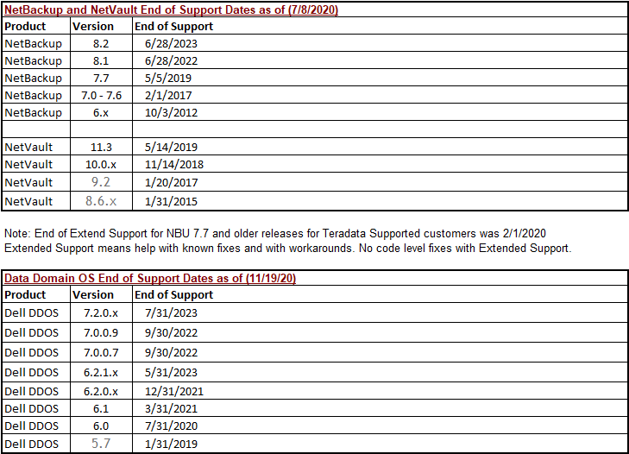
Teradata BAR
*Double click on the table to open links

Slide 9
Viewpoint, Ecosystem Manager, Data Mover, Unity
Products | TMS OS | TMS OS | Cloud OS | TMS OS | Cloud OS | Internal Repository | GCA Date
 | SLES11 SP1 STND | SLES11 SP3 STND | SLES11 SP3 STND | SLES12 SP3 STND | SLES 12SP3 TDC
Ecosystem Manager 15.11 | P | P | X | X | X | TD 15.10 | May-12
Ecosystem Manager 16.00 | X | P | P | X | X | TD 15.10 | Jan-14
Ecosystem Manager 16.10 | X | P | P | X | X | TD 15.10 | Apr-14
Ecosystem Manager 16.20 | X | P | P | X | X | TD 15.10 | Apr-20
Ecosystem Manager 16.20.34 (EOS) | X | P | X | P | X | SLES 11 SP3 TD 15.10 or | Dec-20
 |  |  |  |  |  | SLES 12 SP3 TD 16.20
For other products please see the following links:
Viewpoint/Data Lab
Data Mover
Unity

Slide 10
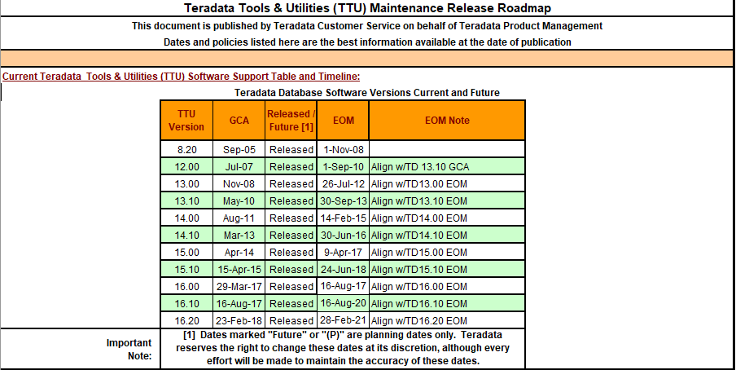
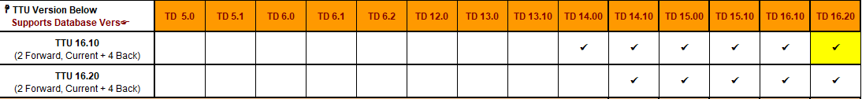
Hadoop Roadmap

Slide 11
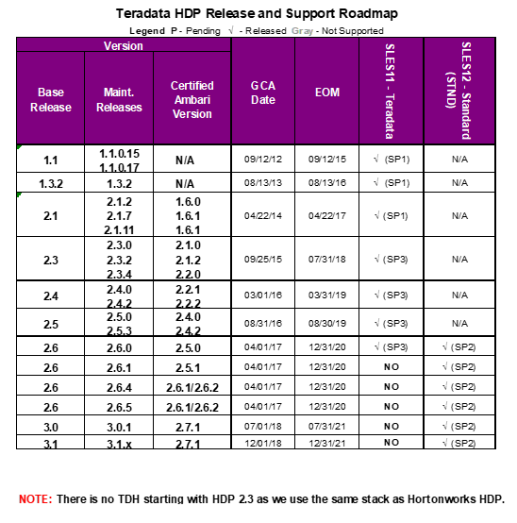
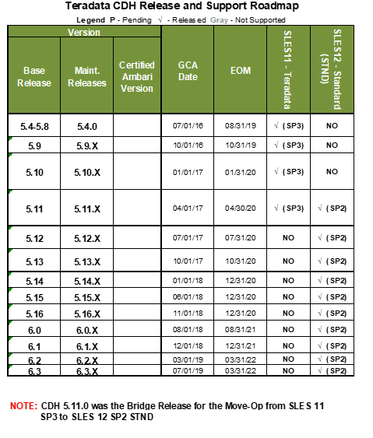
Hadoop Release Information

Slide 12
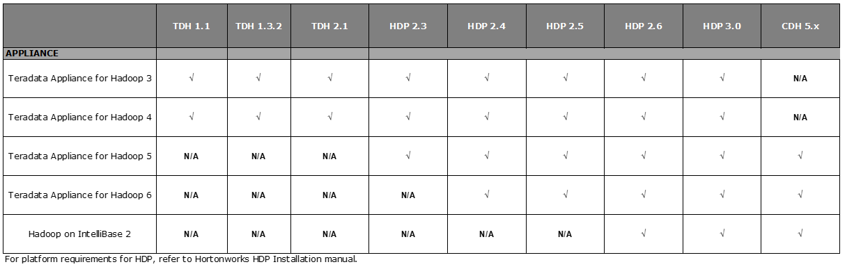
Hadoop Platform Compatibility

Slide 13
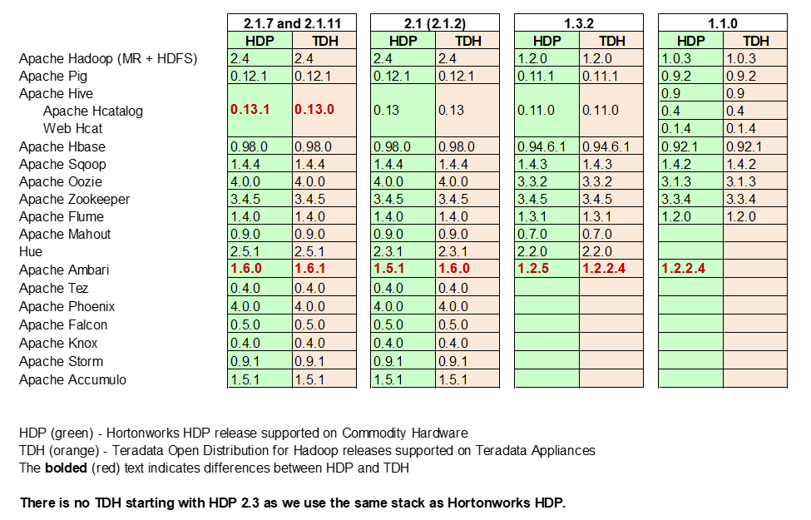
TD Hadoop to Hortonworks Hadoop Comparison

Slide 14
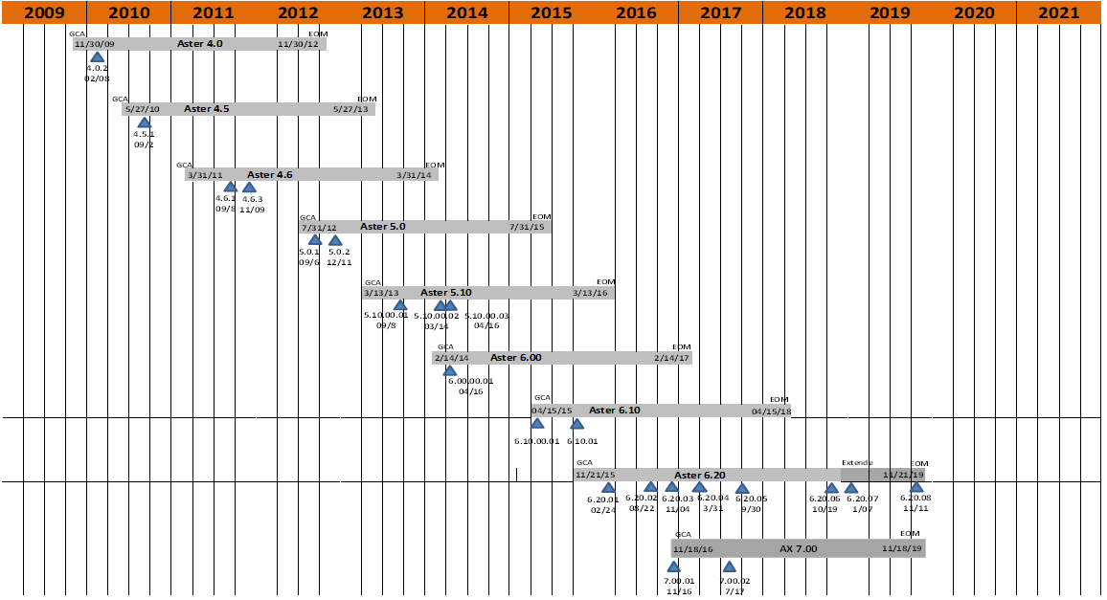
Aster Database Roadmap

Slide 15
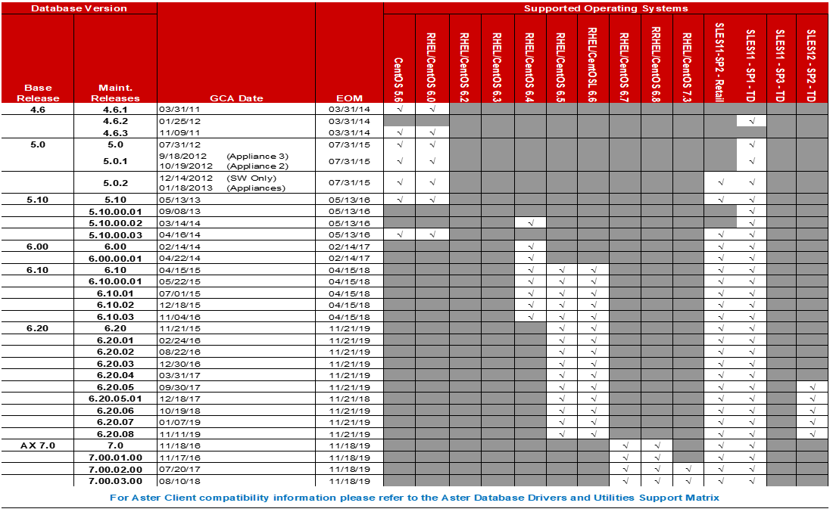
Aster Database Release Information

Slide 16
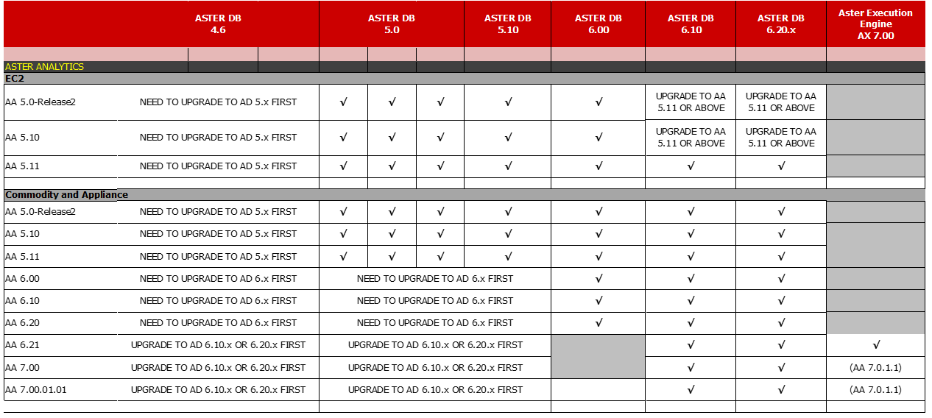
Aster Analytics

Slide 17
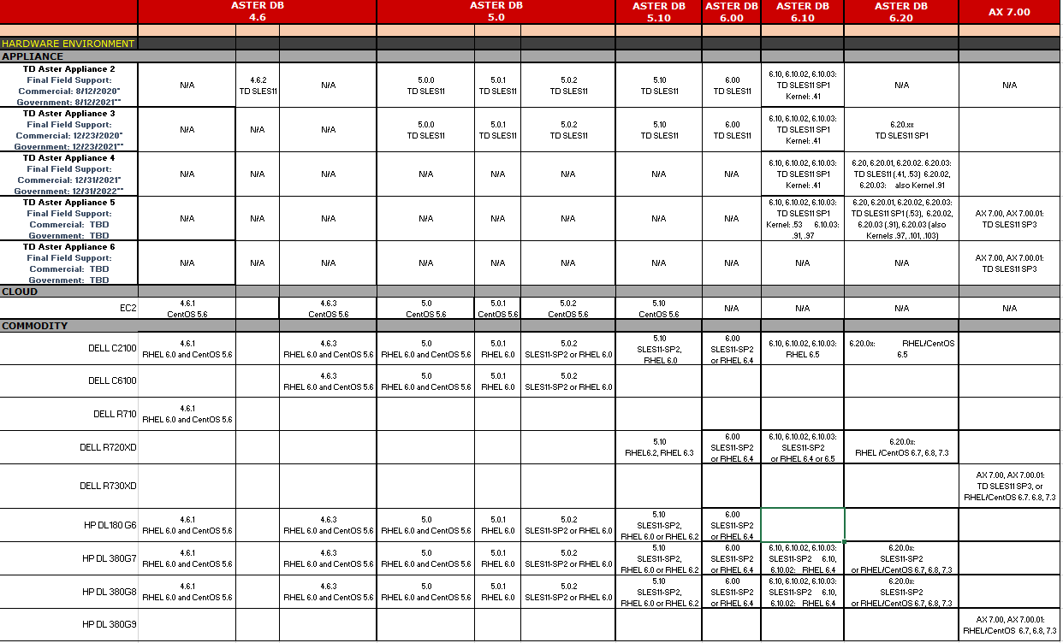
Aster Platform Roadmap

Slide 18
Backup

Slide 19
Revision History
Revision History Rows representing the most recent changes
Date | Version | Change Description | Author | Tab Name
4/10/2020 | B111 | 16.20 EOM Note on TTU Tab updated to Align w/TD16.20 EOM* + EOM updated to 2/28/2022 + note added *Arc 16.20 EOM is Feb 28, 2021 | Jefferson Uy | TTU
6/17/2020 | B112 | Added NBU 8.2 to the BAR SW tab | Tony Nevárez | BAR
6/22/2020 | B113 | Added TTU 17.00 | Jefferson Uy | TTU
7/8/2020 | B114 | Added DDOS 6.2 and DDOS 7.0. Also, modified the wording on EOSL for NV relative to the ARC/TARA EoM date | Tony Nevárez | BAR
11/19/2020 | B115 | Updated DDOS 6.1 EOSS Dates and added EOSS dates for DDOS 6.2, 7.0 and 7.2 | Tony Nevárez | BAR
1/29/2021 | B116 | Updated multiple sheets to include TD 17.05/Added EOM/EDM for 17.05 | John Tango/ Edvin Shahmoradian | IFX-Legacy Database/ XLS Timeline
2/8/2021 | B117 | Added NBU 8.1 and NBU 8.2 End of Support dates | Tony Nevárez | BAR
2/12/2021 | B118 | Updated XLS Timeline, Updated min DBS version required for SLES12 SP3/16.20 U2 | John Tango | XLS Timeline, IFX-Legacy Database
3/23/2021 | B119 | Updated "updated date" for NBU and NV life cycle dates | Tony Nevárez | BAR
7/21/2021 | Jul21_2021 - V1 | Added BAR Storage to "Platform" worksheet and deleted blank rows for Aster/Hadoop | Tony Nevarez | Platform
8/4/2021 | B120 | Updated DDOS EOSS dates | Tony Nevárez | BAR
8/5/2021 | B121 | Updated XLS Timeline, added 17.10 GA/EOM date | John Tango | XLS Timeline, IFX-Legacy Database

Slide 20
Sources
Slide | Source | Document Name | Source Tab Name
3 | KB0027406 | TeradataSystemSupportLifecycle | XLS_TimeLine
4 | KB0027406 | TeradataSystemSupportLifecycle | IFX-Legacy Database
5 | KB0027406 | TeradataSystemSupportLifecycle | TTU
6 | KB0027406 | TeradataSystemSupportLifecycle | TTU
7 | KB0027406 | TeradataPlatformDiscontinuationRoadmap: | Platform (2010 & later)
8 | KB0027406 | TeradataSystemSupportLifecycle | BAR SW
9 | KB0027406 | Ecosystem Manager | Infrastructure
10 | KB0027406 | Local Excel sheet | Hadoop Roadmap
11 | KB0027406 | Local Excel sheet | Hadoop Release Info
12 | KB0027406 | Local Excel sheet | Hadoop Platform Compatibility
13 | KB0027406 | Local Excel sheet | TDH vs HDP
14 | KB0027406 | Local Excel sheet | Aster DB Roadmap
15 | KB0027406 | Local Excel sheet | Aster DB Release Info
16 | KB0027406 | Local Excel sheet | Aster Analytics
17 | KB0027406 | Local Excel sheet | Aster Platform Roadmap
19 | KB0027406 | Local Excel sheet | All Cover Sheets

